Slide 1
Data Mining:
Concepts and Techniques
(3rd ed.)
— Chapter 3 —
Jiawei Han, Micheline Kamber, and Jian Pei
University of Illinois at Urbana-Champaign &
Simon Fraser University
©2011 Han, Kamber & Pei. All rights reserved.

Slide 2
Chapter 3: Data Preprocessing
Data Preprocessing: An Overview
  Data Quality
  Major Tasks in Data Preprocessing
Data Cleaning
Data Integration
Data Reduction
Summary

Slide 3
Data Quality: Why Preprocess the Data?
Measures for data quality: A multidimensional view
  Accuracy: correct or wrong, accurate or not
  Completeness: not recorded, unavailable, …
  Consistency: some modified but some not, dangling, …
  Timeliness: timely update?
  Believability: how trustable the data are correct?
  Interpretability: how easily the data can be understood?

Slide 4
Major Tasks in Data Preprocessing
Data cleaning
  Fill in missing values, smooth noisy data, identify or remove outliers, and resolve inconsistencies
Data integration
  Integration of multiple databases, data cubes, or files
Data reduction
  Dimensionality reduction
  Numerosity reduction
  Data compression
Data transformation and data discretization
  Normalization
  Concept hierarchy generation

Slide 5
Chapter 3: Data Preprocessing
Data Preprocessing: An Overview
  Data Quality
  Major Tasks in Data Preprocessing
Data Cleaning
Data Integration
Data Reduction
Summary

Slide 6
Data Cleaning
Data in the Real World Is Dirty: Lots of potentially incorrect data, e.g., instrument faulty, human or computer error, transmission error
  incomplete: lacking attribute values, lacking certain attributes of interest, or containing only aggregate data
    e.g., Occupation=“ ” (missing data)
  noisy: containing noise, errors, or outliers
    e.g., Salary=“−10” (an error)
  inconsistent: containing discrepancies in codes or names, e.g.,
    Age=“42”, Birthday=“03/07/2010”
    Was rating “1, 2, 3”, now rating “A, B, C”
  Intentional (e.g., disguised missing data)
    Jan. 1 as everyone’s birthday?

Slide 7
Incomplete (Missing) Data
Data is not always available
  E.g., many tuples have no recorded value for several attributes, such as customer income in sales data
Missing data may be due to
  inconsistent with other recorded data and thus deleted
  data not entered due to misunderstanding
  certain data may not be considered important at the time of entry
  not register history or changes of the data

Slide 8
How to Handle Missing Data?
Ignore the tuple: usually done when class label is missing (when doing classification
Fill in the missing value manually: tedious + infeasible?
Fill in it automatically with
  a global constant : e.g., “unknown”, a new class?!
  the attribute mean
  the attribute mean for all samples belonging to the same class: smarter
  the most probable value: inference-based such as Bayesian formula or decision tree

Slide 9
Noisy Data
Noise: random error or variance in a measured variable
Incorrect attribute values may be due to
  faulty data collection instruments
  data entry problems
  data transmission problems
  technology limitation
  inconsistency in naming convention
Other data problems which require data cleaning
  duplicate records
  incomplete data
  inconsistent data

Slide 10
How to Handle Noisy Data?
Binning
  first sort data and partition into (equal-frequency) bins
  then one can smooth by bin means, smooth by bin median, smooth by bin boundaries, etc.
Regression
  smooth by fitting the data into regression functions
Clustering
  detect and remove outliers
Combined computer and human inspection
  detect suspicious values and check by human (e.g., deal with possible outliers)

Slide 11
Data Cleaning as a Process
Data discrepancy detection
  Use metadata (e.g., domain, range, dependency, distribution)
  Check field overloading
  Check uniqueness rule, consecutive rule and null rule
  Use commercial tools
    Data scrubbing: use simple domain knowledge (e.g., postal code, spell-check) to detect errors and make corrections
    Data auditing: by analyzing data to discover rules and relationship to detect violators (e.g., correlation and clustering to find outliers)
Data migration and integration
  Data migration tools: allow transformations to be specified
  ETL (Extraction/Transformation/Loading) tools: allow users to specify transformations through a graphical user interface
Integration of the two processes
  Iterative and interactive (e.g., Potter’s Wheels)

Slide 12
Chapter 3: Data Preprocessing
Data Preprocessing: An Overview
  Data Quality
  Major Tasks in Data Preprocessing
Data Cleaning
Data Integration
Data Reduction
Summary

Slide 13
Data Integration
Data mining often requires data integration—the merging of data from multiple data stores.
Careful integration can help reduce and avoid redundancies and inconsistencies in the resulting data set.
This can help improve the accuracy and speed of the subsequent data mining process.
Data Mining: Concepts and Techniques

Slide 14
Data Integration : Entity Identification Problem
How can equivalent real-world entities from multiple data sources be matched up? This is referred to as the entity identification problem.
For example, how can the data analyst or the computer be sure that customer id in one database and cust number in another refer to the same attribute?
Data Mining: Concepts and Techniques

Slide 15
Entity Identification Problem
Any Solution
Data Mining: Concepts and Techniques

Slide 16
Solution: Metadata
Examples of metadata for each attribute include the name, meaning, data type, and range of values permitted. Such metadata can be used to help avoid errors in schema integration.
Data Mining: Concepts and Techniques

Slide 17
Data Integration : Redundancy and Correlation Analysis
Redundancy is another important issue in data integration. An attribute (such as annual revenue, for instance) may be redundant if it can be “derived” from another attribute or set of attributes.
Data Mining: Concepts and Techniques

Slide 18
Redundancy detection methods
Some redundancies can be detected by correlation analysis. Given two attributes, such analysis can measure how strongly one attribute implies the other, based on the available data.
For nominal data, we use the χ2 (chi-square) test.
For numeric attributes, we can use the correlation coefficient and covariance,
Data Mining: Concepts and Techniques

Slide 19

Correlation Analysis (Nominal Data)
Χ² (chi-square) test
The larger the Χ² value, the more likely the variables are related

Slide 20
Example
 | male | female | Total
fiction | 250 | 200 | 450
Non-fiction | 50 | 1000 | 1050
 | 300 | 1200 | 1500
In above example male and female are correlated or not ?
Data Mining: Concepts and Techniques

Slide 21
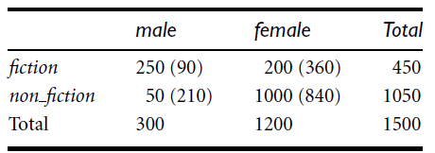
Example
Data Mining: Concepts and Techniques

Slide 22


How to Find exptected
Data Mining: Concepts and Techniques

Slide 23
Chi-Square Calculation: An Example
Χ² (chi-square) calculation (numbers in parenthesis are expected counts calculated based on the data distribution in the two categories)

Slide 24
Chapter 3: Data Preprocessing
Data Preprocessing: An Overview
  Data Quality
  Major Tasks in Data Preprocessing
Data Cleaning
Data Integration
Data Reduction

Slide 25
Data Reduction Strategies
Data reduction: Obtain a reduced representation of the data set that is much smaller in volume but yet produces the same (or almost the same) analytical results
  Dimensionality reduction, e.g., remove unimportant attributes
    Principal Components Analysis (PCA) (Dimensionality reduction)

Slide 26
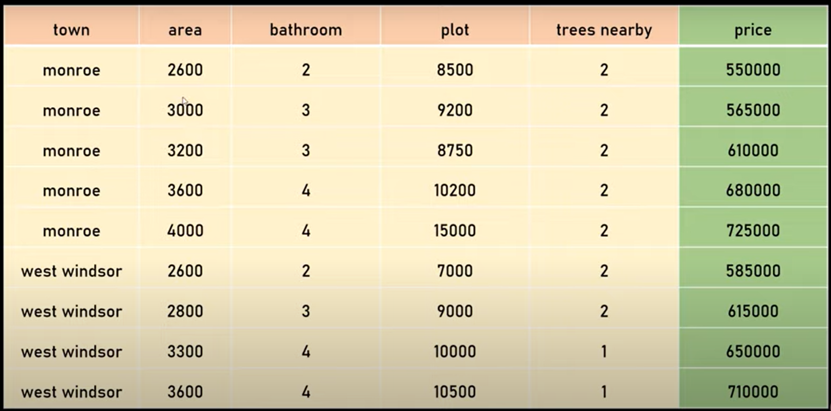

Principal Components Analysis (PCA)

Slide 27


Slide 28
0
1
2
9

Slide 29
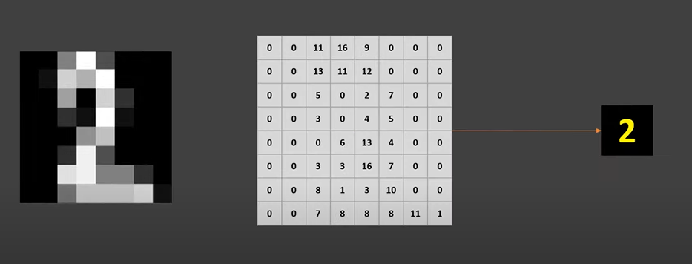

Slide 30
8 by 8 grid
64 features

Slide 31

All pixels import in this image ?

Slide 32

Let take these two pixel

Slide 33
What if we get rid of non important features?

Slide 34
What if we get rid of non important features?
Two benefits:
  Faster training
  Data visualization became easier

Slide 35
Principal Component Analysis (PCA)
PCA is a process of figuring out most important features (also called principal components) that has the most impact on the target variable.

Slide 36

Lets take example

Slide 37
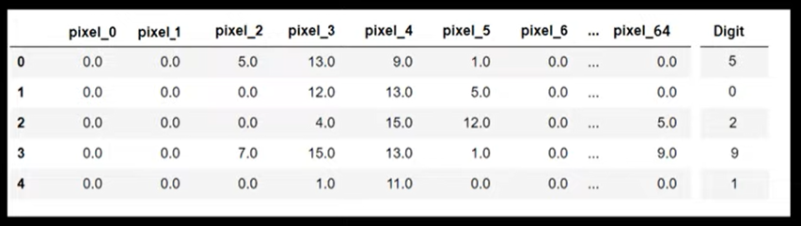
Lets take example

Slide 38
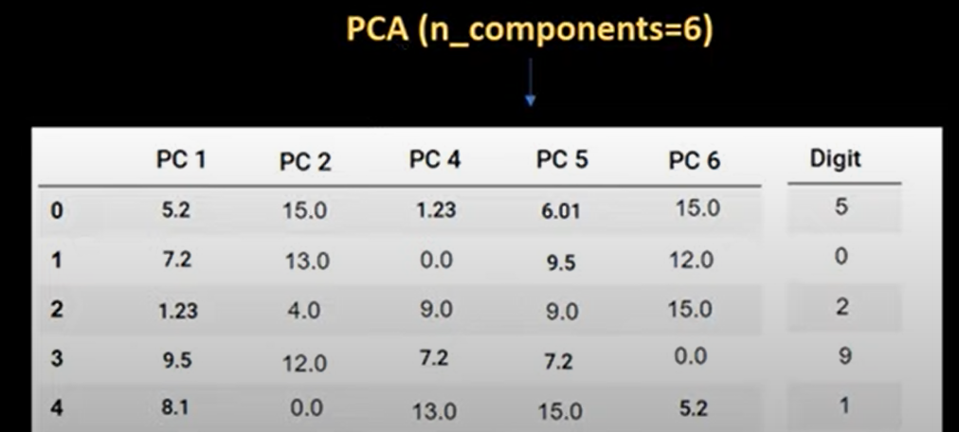
Lets take example

Slide 39
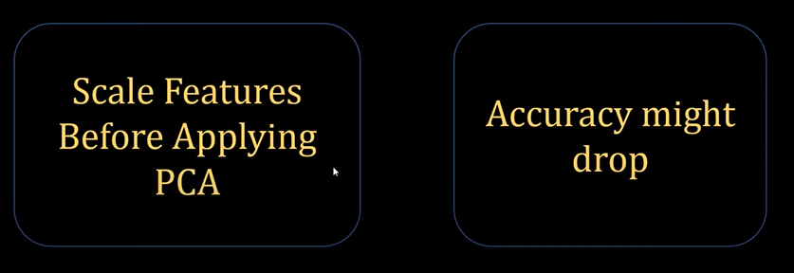
Few things to keep in mind before using PCA

Slide 40
Keep in mind that many times doing PCA reduces the accuracy but computation is much lighter and that's the trade off you need to consider while building models in real life.

Slide 41
Summary
PCA is called dimensionality reduction method as it can help to reduce dimension.

Slide 42
Coding
Lets apply PCA digits dataset

Slide 43
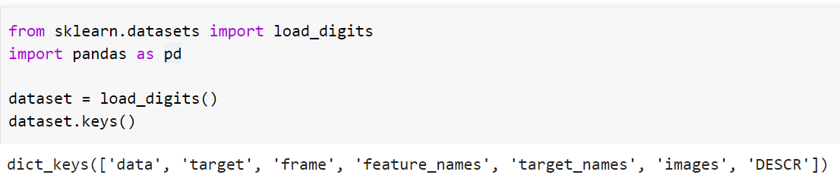
Load dataset

Slide 44
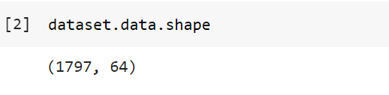
Shape of data
Samples (Rows): 1797
Features (columns) : 64

Slide 45
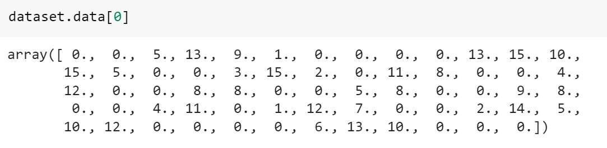
Explore the single sample in dat

Slide 46
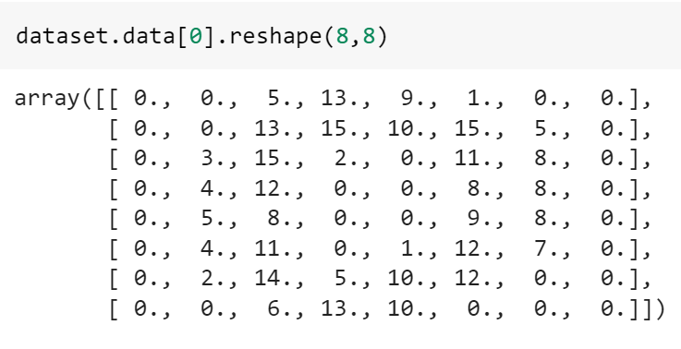
Reshape the sample 64 into 8x8 numpy array

Slide 47
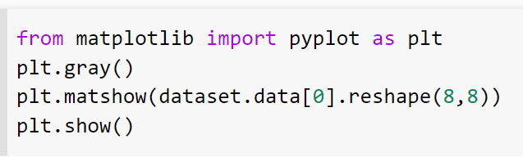
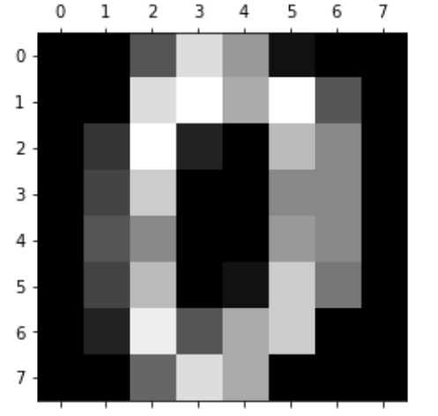
Visualize the digit using matplot

Slide 48
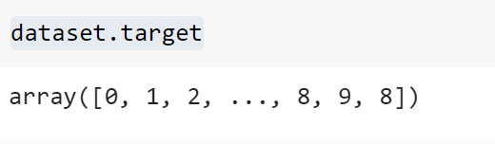
Print the target values

Slide 49
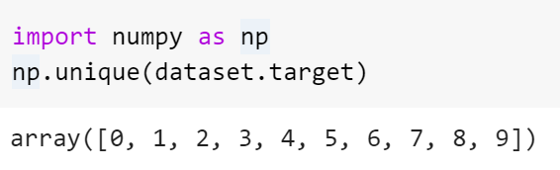
Print only the unique target values

Slide 50
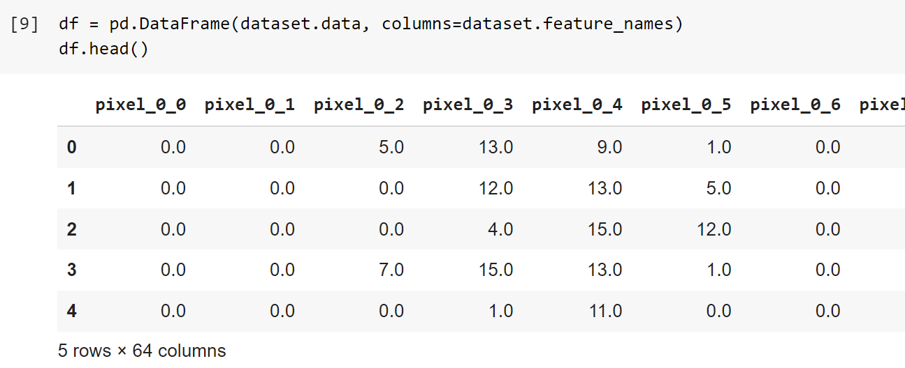
Load data as pandas df

Slide 51
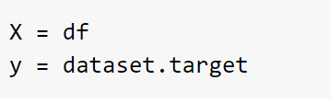
Assign features to X and target values to y

Slide 52
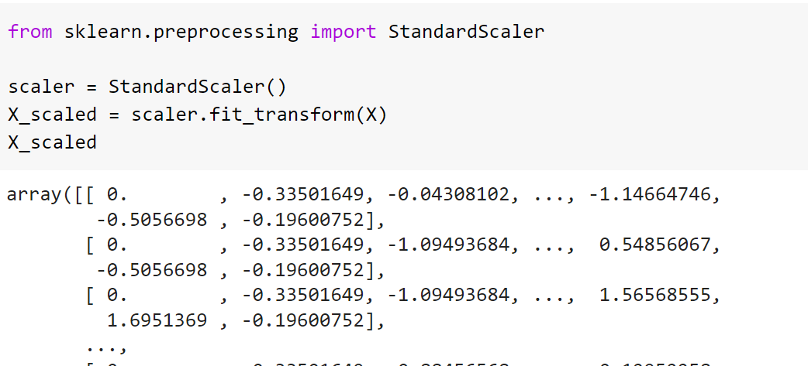
Perform scaling on data

Slide 53
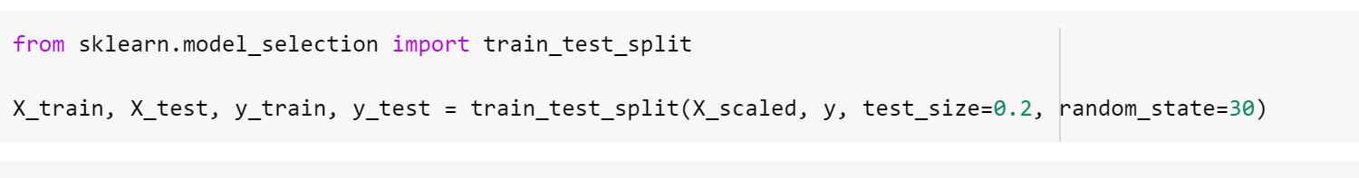
Split data into train and test set

Slide 54
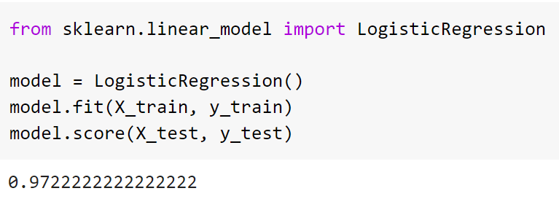
Train model on train data and evaluate on test data

Slide 55
Now train and evaluate model after applying PCA on data

Slide 56
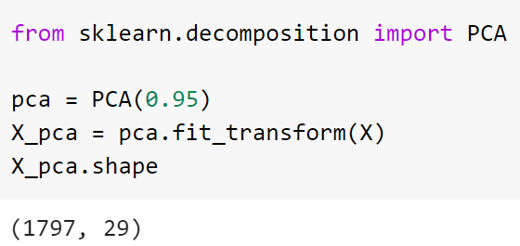
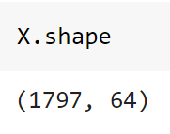
Use PCA to reduce dimensions
Pick 95% most important features
Dimension reduce from 64 to
29

Slide 57
Split data into train and test set

Slide 58
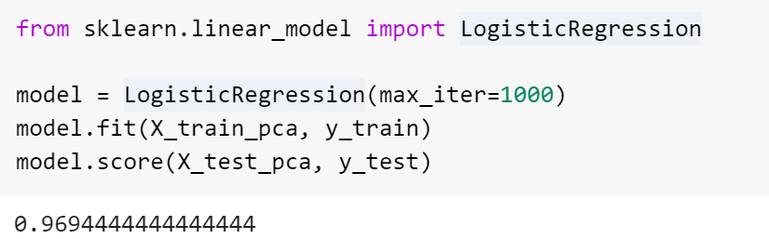
Train model on train data and evaluate on test data

Slide 59
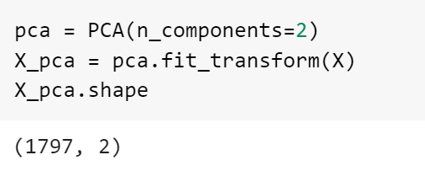
Let's now select only two components

Slide 61
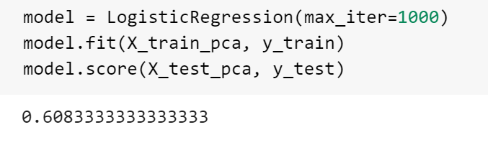

Slide 62
summary
Method | Data dimension | Accuracy
LR | 64 | 77.2
LR + PCA (0.75) | 29 | 76.9
LR + PCA(n_com = 2) | 2 | 66.8

Slide 63
PCA Exercise
Please go to Gdrive
Folder name data mining is shared with you
Open the Google doc file PCA exercise and follow the instructions.

